Slide 1
Printer
Ferenc borsos

Slide 2
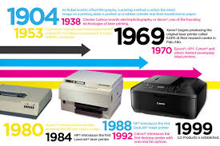
History
The first computer printer designed was a mechanically driven apparatus by Charles Babbage for his difference engine in the 19th century; however, his mechanical printer design was not built until 2000.

Slide 3
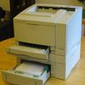
The ink was a red stamp pad ink manufactured by Phillips Process Company of Rochester, NY under the name Clear Print. This patent (US3060429) led to the Teletype Inktronic Printer product delivered to customers in late 1966.
The first electronic printer was the EP-101, invented by Japanese company Epson and released in 1968

Slide 4
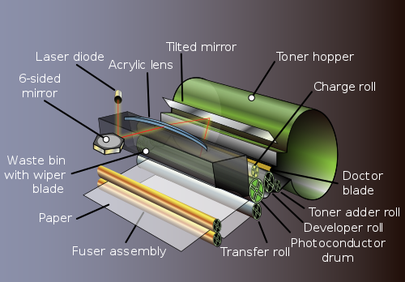
Laser printer
The introduction of the low-cost laser printer in 1984 with the first HP LaserJet, and the addition of PostScript in next year's Apple LaserWriter, set off a revolution in printing known as desktop publishing.
Laser printers using PostScript mixed text and graphics, like dot-matrix printers, but at quality levels formerly available only from commercial typesetting systems.

Slide 5
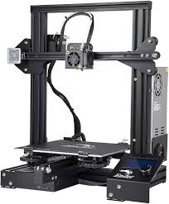
3D printer
A 3D printer is a device for making a three-dimensional object from a 3D model or other electronic data source through additive processes in which successive layers of material (including plastics, metals, food, cement, wood, and other materials) are laid down under computer control.

Slide 6
Technology
The choice of print technology has a great effect on the cost of the printer and cost of operation, speed, quality and permanence of documents, and noise. Some printer technologies do not work with certain types of physical media, such as carbon paper or transparencies.
A second aspect of printer technology that is often forgotten is resistance to alteration: liquid ink, such as from an inkjet head or fabric ribbon, becomes absorbed by the paper fibers, so documents printed with liquid ink are more difficult to alter than documents printed with toner or solid inks, which do not penetrate below the paper surface.

Slide 7
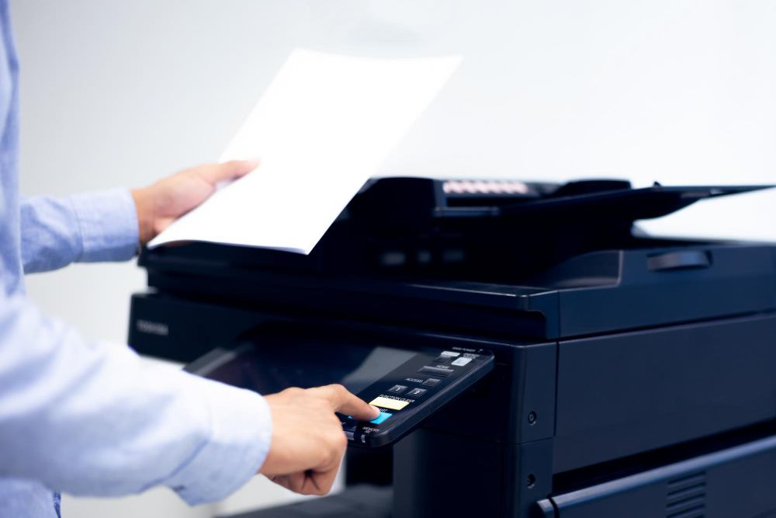
Thank you for your attention!

